Slide 1
Data Link layer and Physical Layer
Dr. Geetha. V
Dept of IT,
NITK Surathkal

Slide 2
Index
Ethernet (IEEE 802.3)
Functions of Data Link Layer
Error Control
Flow Control
Medium Access Control
Token Ring (IEEE 802.5),
Wireless (IEEE 802.11),
WPAN (IEEE 802.15.4)

Slide 3
Ethernet (IEEE 802.3)
Ethernet: It is a LAN protocol that is used in Bus and Star topologies and implements CSMA/CD as the medium access method
Original (traditional) Ethernet developed in 1980 by three companies: Digital, Intel, Xerox (DIX).
In 1985, the Computer Society of the IEEE started a project, called Project 802, to set standards to enable intercommunication among equipment from a variety of manufacturers.
Current version is called IEEE Ethernet

Slide 4
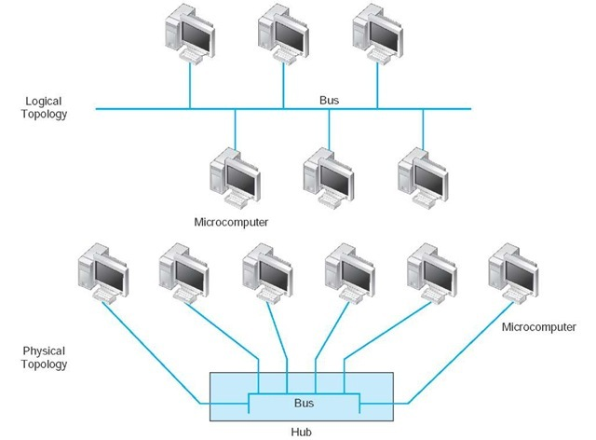
Ethernet (IEEE 802.3)
Bus Topology
Broadcast in nature
Uses Medium Access Control to share the medium

Slide 5
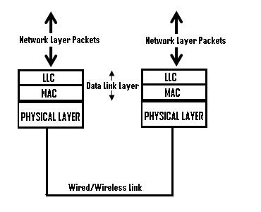
Ethernet
In IEEE 802.3 Ethernet Data link layer is split into two sublayers:
Bottom part: MAC
The frame is called IEEE 802.3
Handles framing, MAC addressing, Medium Access control
Specific implementation for each LAN protocol
Defines CSMA/CD as the access method for Ethernet LANs and Token passing method for Token Ring.
Implemented in hardware
Top part: LLC (Logical Link Control)
The subframe is called IEEE 802.2
Provides error and flow control if needed
It makes the MAC sublayer transparent
Allows interconnectivity between different LANs data link layers
Used to multiplex multiple network layer protocols in the data link layer frame
Implemented in software

Slide 6
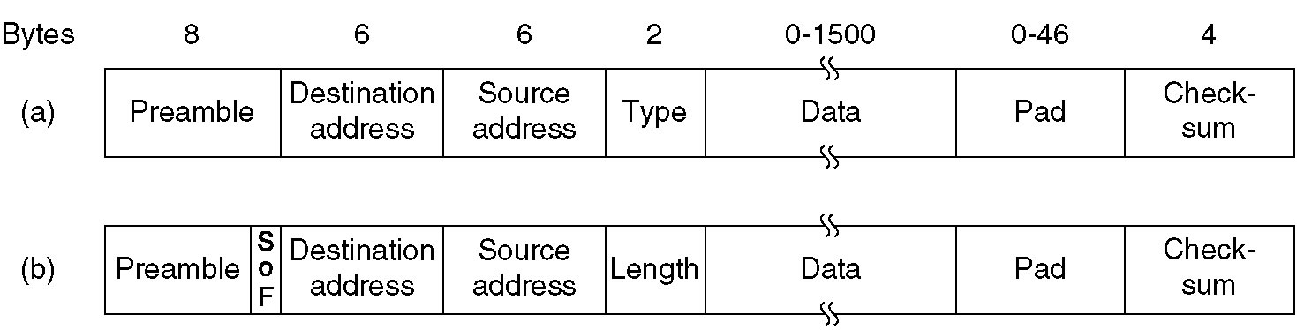
Ethernet
Frame formats. (a) DIX Ethernet , (b) IEEE 802.3
Preamble:The preamble consists of a 56-bit (seven-byte) pattern of alternating 1 and 0 bits
Dest and Source address
Type: 0x0800 – IPv4, 0x0806-ARP, 0x86DD –IPv6
SoF: Start of Frame, 10101011
Length: range is 0 to 65534, but limitation 1500
FCS
FCS

Slide 7

Ethernet Address
Six bytes = 48 bits
Flat address not hierarchical
Burned into the NIC ROM
First three bytes from left specify the vendor. Cisco 00-00-0C, 3Com 02-60-8C and the last 24 bit should be created uniquely by the company
Destination Address can be:
Unicast: second digit from left is even (one recipient)
Multicast: Second digit from left is odd (group of stations to receive the frame – conferencing applications)
Broadcast (ALL ones) (all stations receive the frame)
Source address is always Unicast

Slide 8
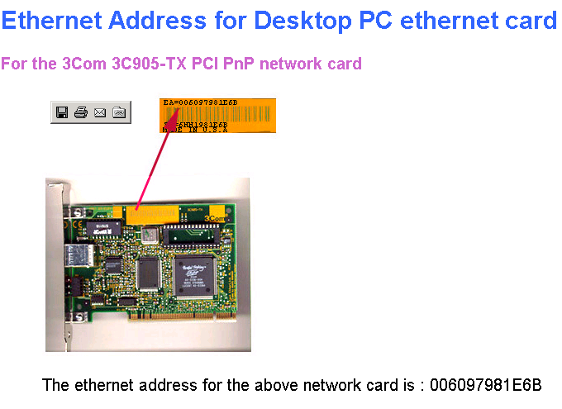

Slide 9
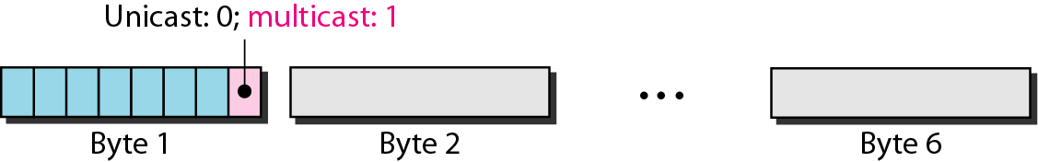
Unicast /Multicast Address

Slide 10
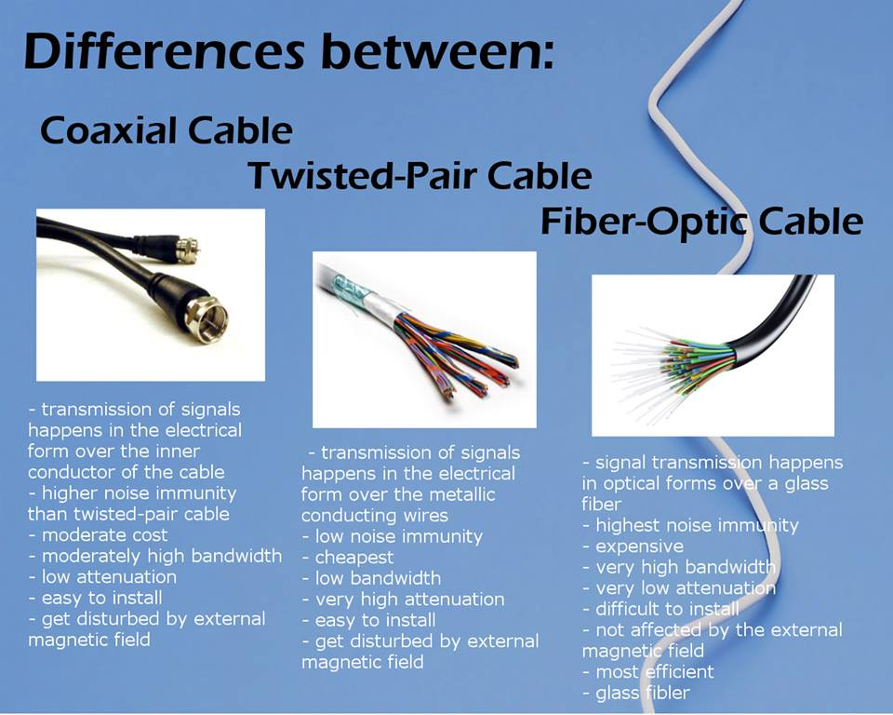
Transmission Medium

Slide 11
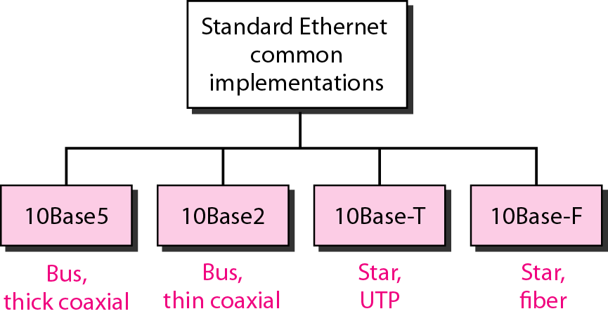
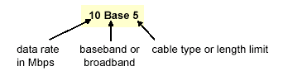
Categories of traditional Ethernet
<data rate><Signaling method><Max segment length or cable type>

Slide 12
IEEE 802.3 Cable Types
Name | Cable Max. | Max Cable Segment Length | Nodes /segment
10Base5 | thick coax | 500 meters | 100
10Base2 | thin coax | 185 meters | 30
10BaseT | twisted pair | 100 meters | 1
10BaseF | Fiber Optic | 2Km | 1
Toplogy
Bus
Bus
Star
Star

Slide 13
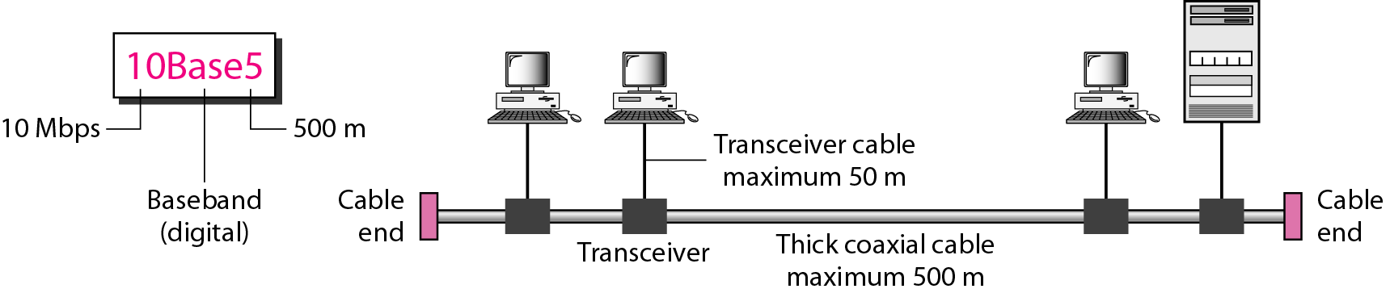
10Base5 implementation

Slide 14
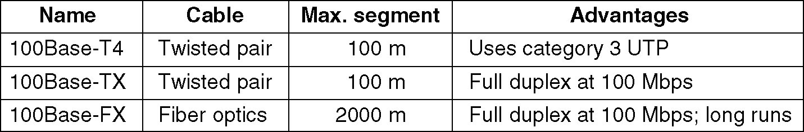
Fast Ethernet
100 Mbps transmission rate
same frame format, media access, and collision detection rules as 10 Mbps Ethernet
can combine 10 Mbps Ethernet and Fast Ethernet on same network using a switch
media: twisted pair (CAT 5) or fiber optic cable (no coax)
Star-wire topology
Similar to 10BASE-T
CAT 3
CAT 5

Slide 15
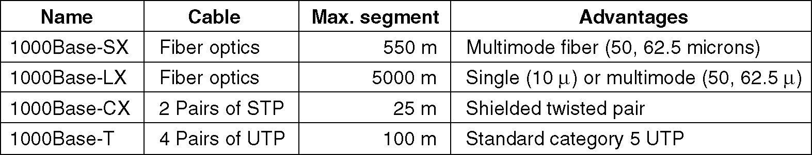
Gigabit Ethernet
Speed 1Gpbs
Minimum frame length is 512 bytes
Operates in full/half duplex modes mostly full duplex

Slide 16
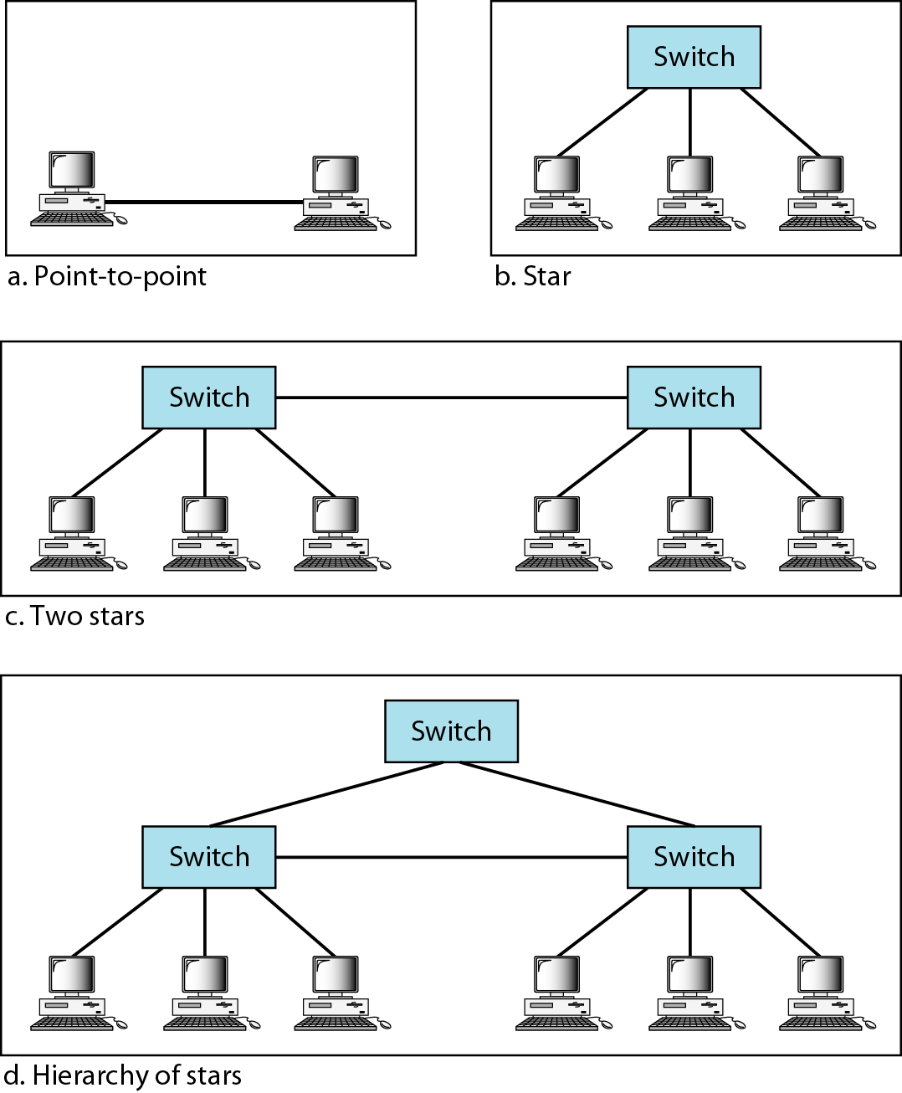
Figure 13.22 Topologies of Gigabit Ethernet

Slide 17
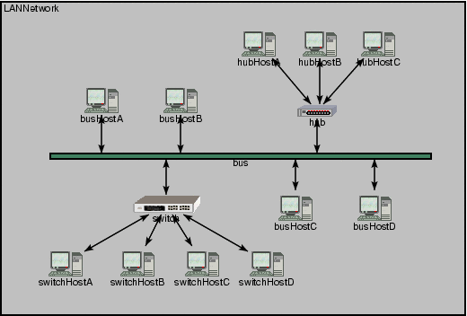

Slide 18
Index
Ethernet (IEEE 802.3)
Functions of Data Link Layer
Error Control
Flow Control
Medium Access Control
Token Ring (IEEE 802.5),
Wireless (IEEE 802.11),
WPAN (IEEE 802.15.4)

Slide 19
Ethernet
Frame formats. (a) DIX Ethernet , (b) IEEE 802.3
Preamble:The preamble consists of a 56-bit (seven-byte) pattern of alternating 1 and 0 bits
Dest and Source address
Type: 0x0800 – IPv4, 0x0806-ARP, 0x86DD –IPv6
SoF: Start of Frame, 10101011
Length: range is 0 to 65534, but limitation 1500
FCS
FCS

Slide 20
Error Control Techniques
One dimensional Parity
Two Dimensional Parity
Checksum
Cyclic Redundancy Code
Hamming Code

Slide 21
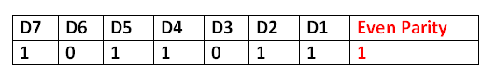
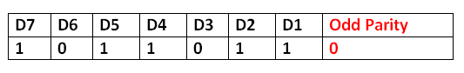
1. Parity Check
Even Parity: number of 1’s is even
Odd Parity: number of 1’s is even
Cannot identify even number of changes

Slide 22
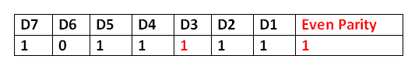
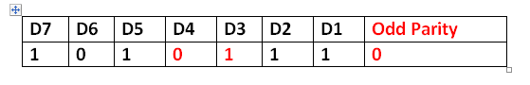
1. Parity Check
Even Parity: number of 1’s is even
Odd Parity: number of 1’s is even
Cannot identify even number of changes

Slide 23
2. 2D Parity Check
2D parity Check
D7 | D6 | D5 | D4 | D3 | D2 | D1 | Even Parity
1 | 0 | 1 | 0 | 1 | 1 | 1 | 1
0 | 1 | 0 | 1 | 0 | 0 | 1 | 1
0 | 1 | 1 | 1 | 0 | 1 | 1 | 1
0 | 0 | 1 | 0 | 0 | 1 | 0 | 0
1 | 1 | 0 | 1 | 0 | 1 | 0 | 0
0 | 0 | 0 | 0 | 1 | 0 | 1 | 0
0 | 1 | 1 | 1 | 0 | 0 | 0 | 1

Slide 24
2. 2D Parity Check
2D parity Check : Error Checking: Parity not matching
D7 | D6 | D5 | D4 | D3 | D2 | D1 | Even Parity
1 | 0 | 1 | 0 | 1 | 1 | 1 | 1
0 | 1 | 0 | 1 | 0 | 0 | 1 | 1
0 | 1 | 1 | 1 | 0 | 1 | 1 | 1
0 | 0 | 1 | 0 | 1 | 1 | 0 | 0 (1)
1 | 1 | 0 | 1 | 0 | 1 | 0 | 0
0 | 0 | 0 | 0 | 1 | 0 | 1 | 0
0 | 1 | 1 | 1 | 0 (1) | 0 | 0 | 1

Slide 25
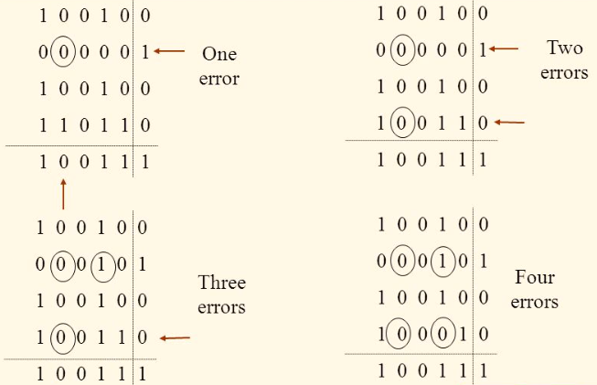
2. 2D Parity Check

Slide 26
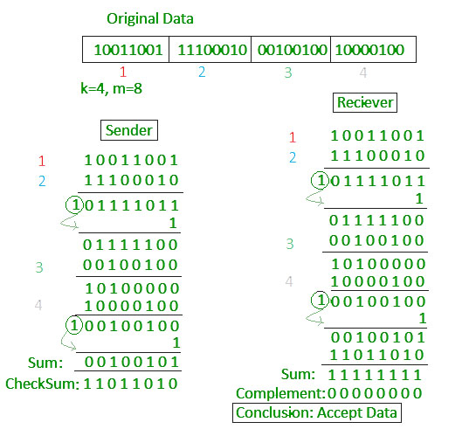
3. Checksum

Slide 27
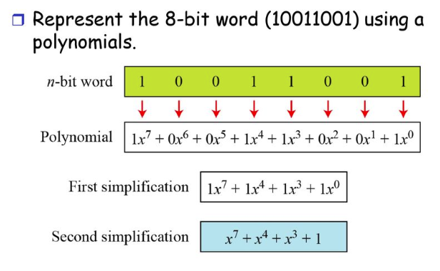
4. Cyclic Redundancy Code
Representation of bits in polynomial form

Slide 28
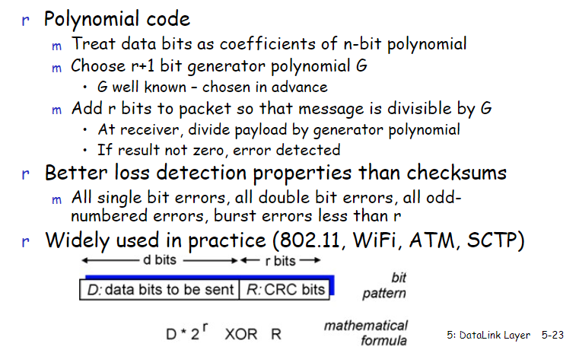
4. Cyclic Redundancy Code

Slide 29
4. Cyclic Redundancy Code
Generator polynomial: x³+1 (1001)
R= highest power of X
Data Bits: 11010011
Now Dividend is 11010011000
Its polynomial
D=11010011 | R=000
x¹⁰+x⁹+x⁷+x⁴+x³

Slide 30
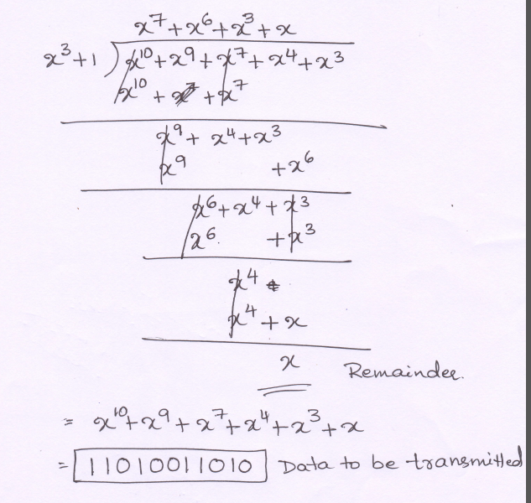
4. Cyclic Redundancy Code
Sender side
Divide the data (D * 2^{r} XOR R) with generated polynomial.
Compute with modulo 2 arithmetic => XOR at each stage
Add the Remainder to Data and send it to receiver.

Slide 31
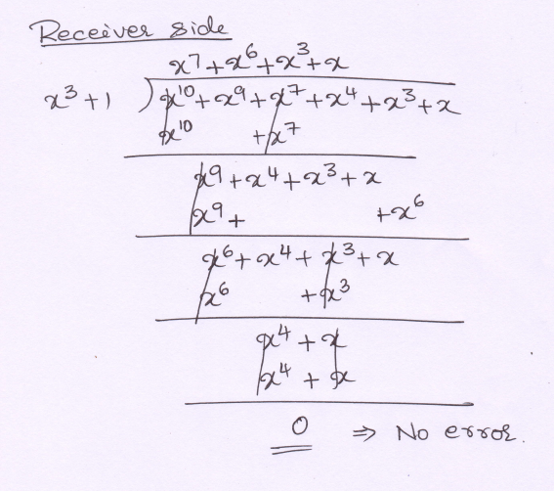
4. Cyclic Redundancy Code
Receiver side:
Received data
Generated polynomial
If remainder is zero, no error in received data
If non zero remainder it indicates error. Then discard the frame and ask for retransmission

Slide 32
4. Cyclic Redundancy Code
Following types of errors can be detected by a G(x) with the stated properties
All single-bit errors, as long as the x^{k} and x⁰ terms have nonzero coefficients
All double-bit errors, as long as G(x) has a factor with at least three terms
Any odd number of errors, as long as G(x) contains the factor (x+1)
Any “burst” error for which the length of the burst is less than k bits.

Slide 33
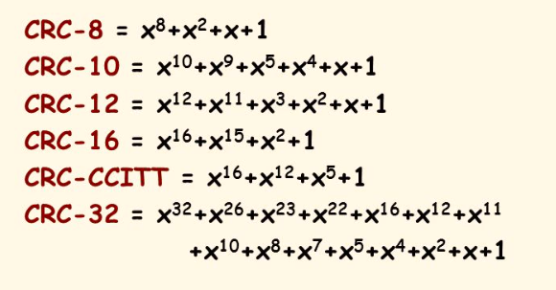
4. Cyclic Redundancy Code
International Standard Generator Polynomial

Slide 34
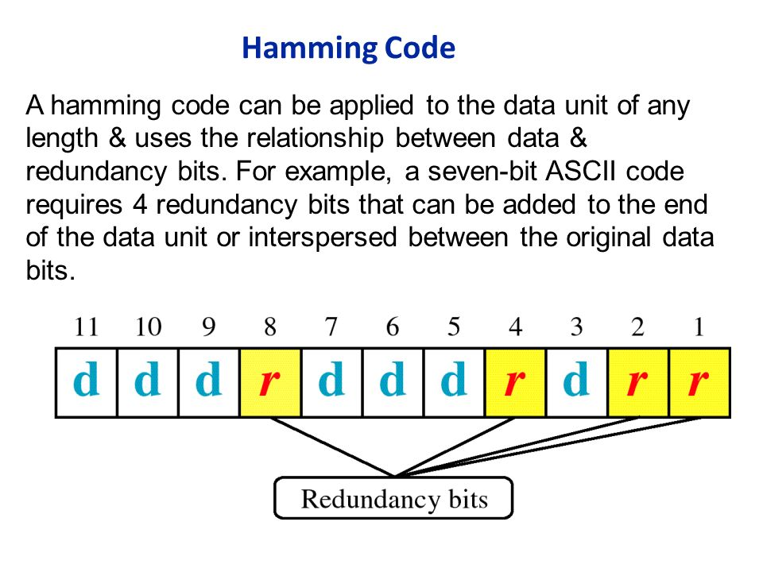

Slide 35
5. Hamming Code
Finding number of redundant bits
2^{r} >=m+r+1
where m= number of Data bits and
r = number of redundant bits
If m=7 bits then r=?
2⁴ ≥ 7 + 4 + 1 so r= 4 bits

Slide 36
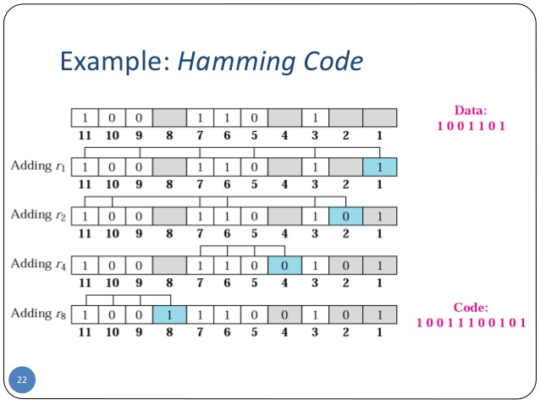

Slide 37
5. Hamming Code
 | 11 | 10 | 9 | 8 | 7 | 6 | 5 | 4 | 3 | 2 | 1
 | D6 | D5 | D4 | R8 | D3 | D2 | D1 | R4 | D0 | R2 | R1
Data | 1 | 0 | 0 |  | 1 | 1 | 0 |  | 1
R1 | 1 |  | 0 |  | 1 |  | 0 |  | 1 |  | R1=1
R2 | 1 | 0 |  |  | 1 | 1 |  |  | 1 | R2=0
R4 |  |  |  |  | 1 | 1 | 0 | R4=0
R8 | 1 | 0 | 0 | R8=1
Data to be transmitted | 1 | 0 | 0 | 1 | 1 | 1 | 0 | 0 | 1 | 0 | 1
Data to be transmitted : 10011100101

Slide 38
5. Hamming Code
Data Received: 11011100101 calculate parity including R bits
R₈ R₄ R₂ R₁ = 1010 => 10th bit is error
 | 11 | 10 | 9 | 8 | 7 | 6 | 5 | 4 | 3 | 2 | 1
 | D6 | D5 | D4 | R8 | D3 | D2 | D1 | R4 | D0 | R2 | R1
Data | 1 | 1 | 0 |  | 1 | 1 | 0 |  | 1
R1 =0 | 1 |  | 0 |  | 1 |  | 0 |  | 1 |  | R1=1
R2=1 | 1 | 1 |  |  | 1 | 1 |  |  | 1 | R2=0
R3=0 |  |  |  |  | 1 | 1 | 0 | R4=0
R4=1 | 1 | 1 | 0 | R8=1
Data to be transmitted | 1 | 0 | 0 | 1 | 1 | 1 | 0 | 0 | 1 | 0 | 1

Slide 39
Index
Ethernet (IEEE 802.3)
Functions of Data Link Layer
Error Control
Flow Control
Medium Access Control

Slide 40
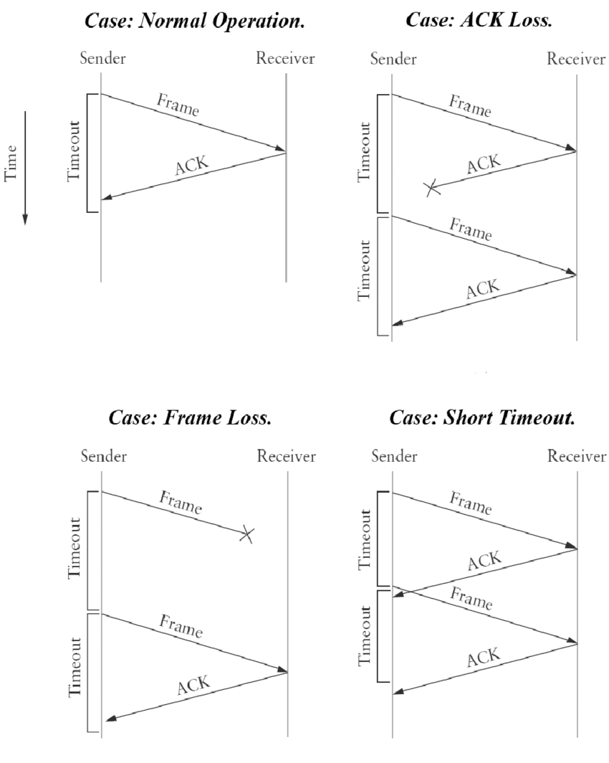
Flow Control
Automatic Repeat Request (ARQ) protocol
Stop and Wait
Go back N
Selective Repeat

Slide 41
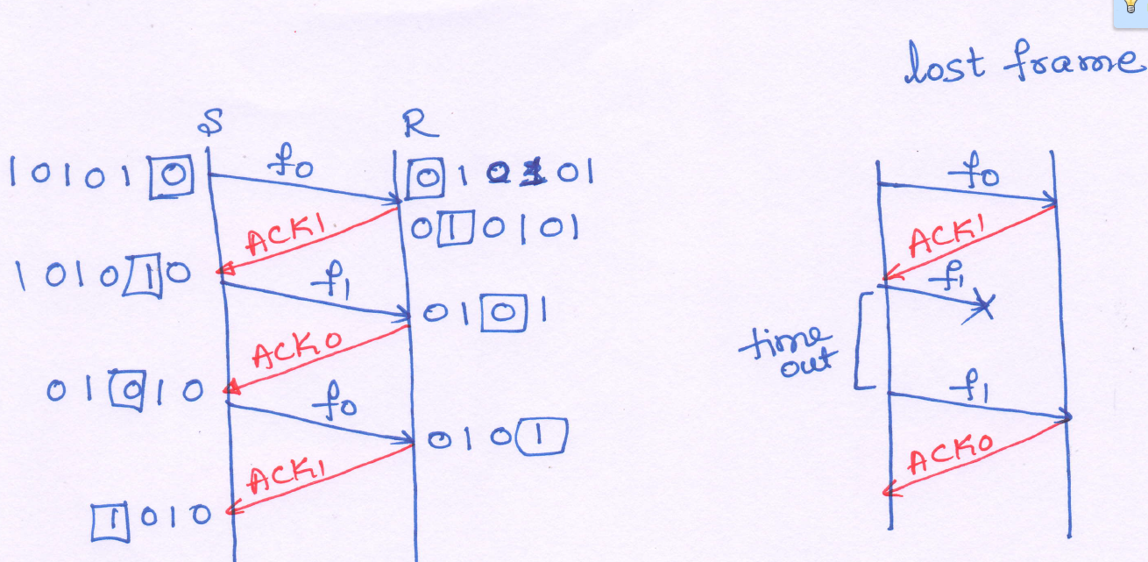
Stop and Wait ARQ

Slide 42
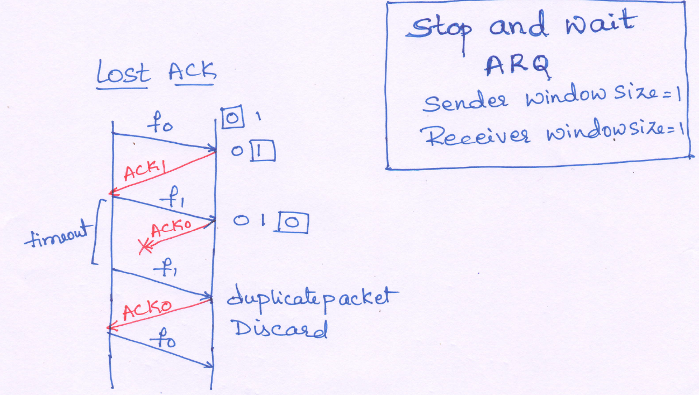
Stop and Wait ARQ

Slide 43
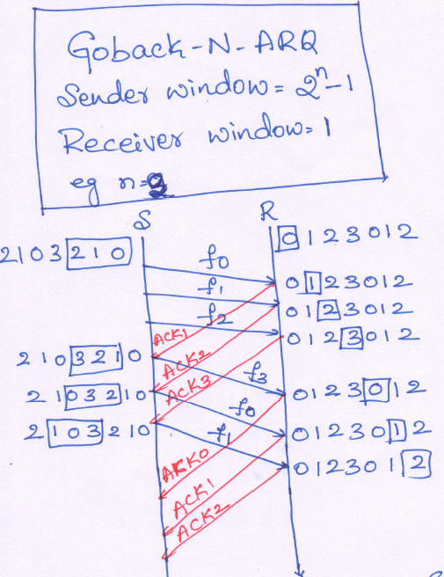
Go back N ARQ

Slide 44
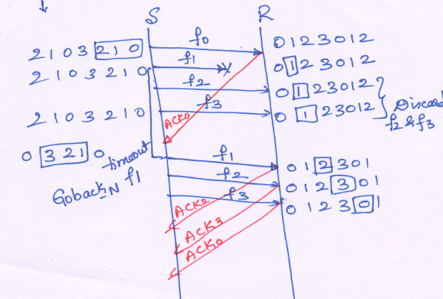
Goback N
Lost frame

Slide 45
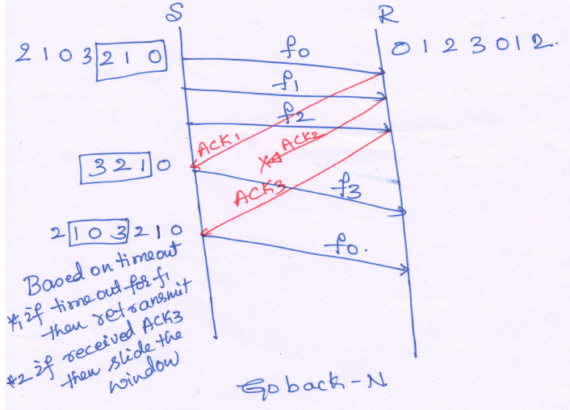
Goback N
Lost ACK

Slide 46
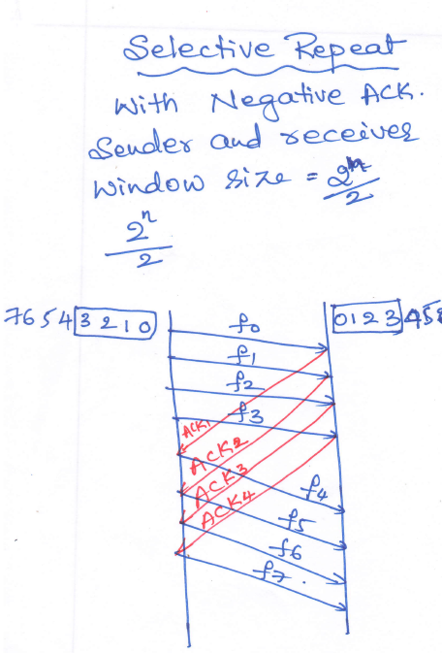
Selective Repeat

Slide 47
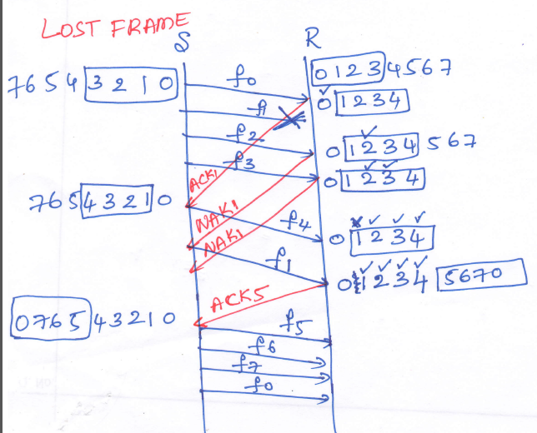
Selective repeat

Slide 48
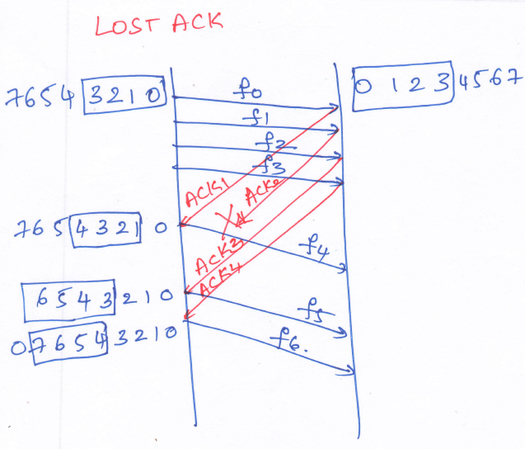
Selective repeat

Slide 49
Index
Ethernet (IEEE 802.3)
Functions of Data Link Layer
Error Control
Flow Control
Medium Access Control

Slide 50
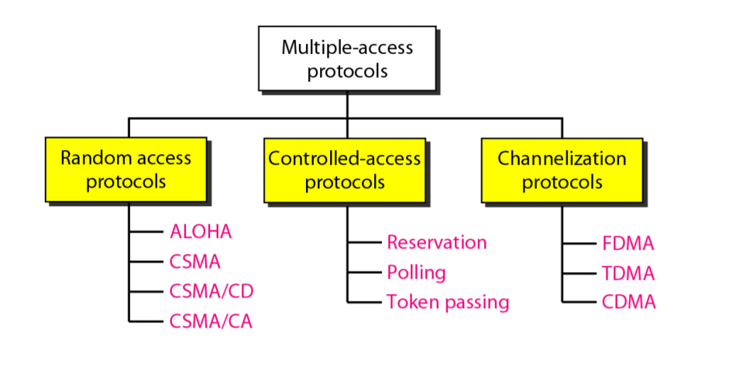

Slide 51
Medium Access Control (MAC)
Aloha
Slotted Aloha
CSMA
CSMA/CD

Slide 52
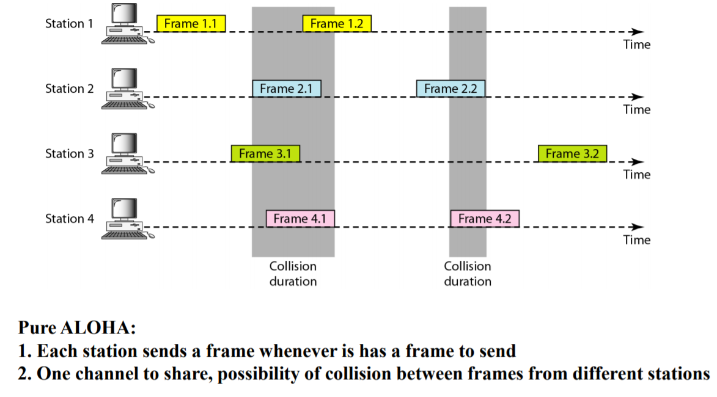
Pure Aloha

Slide 53
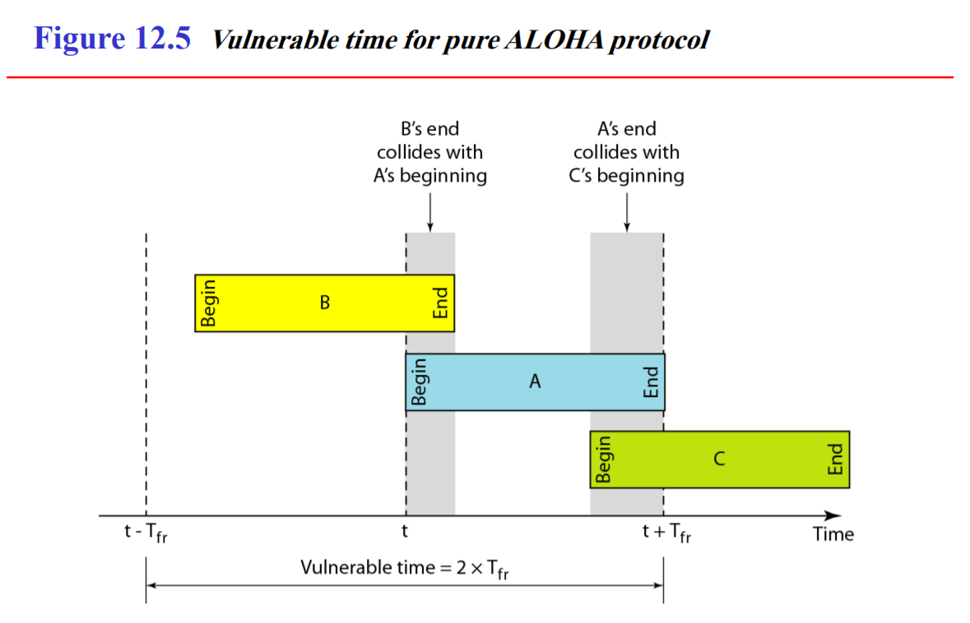

Slide 54
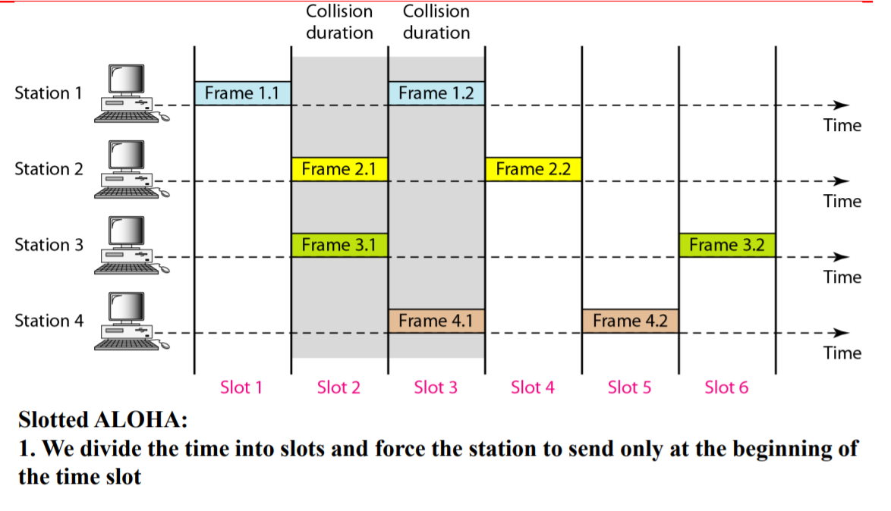
Slotted Aloha

Slide 55
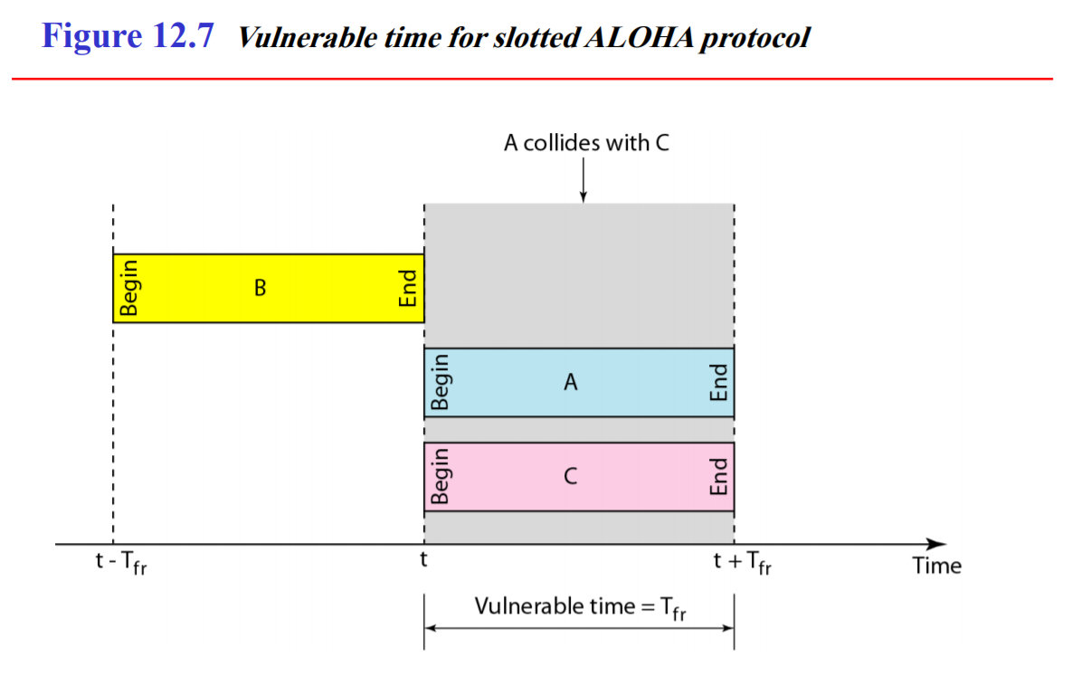

Slide 56
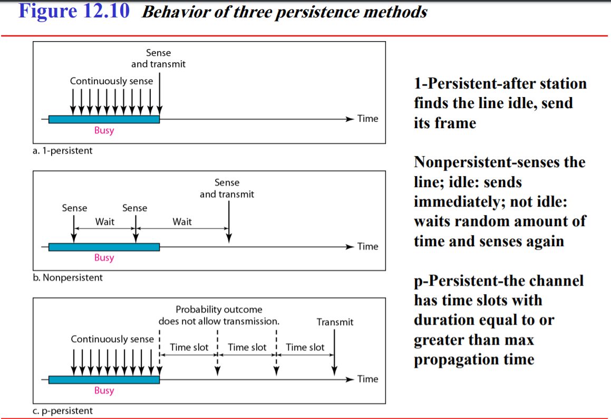
CSMA

Slide 57
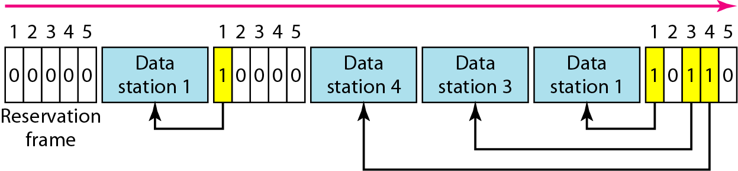
Reservation

Slide 58
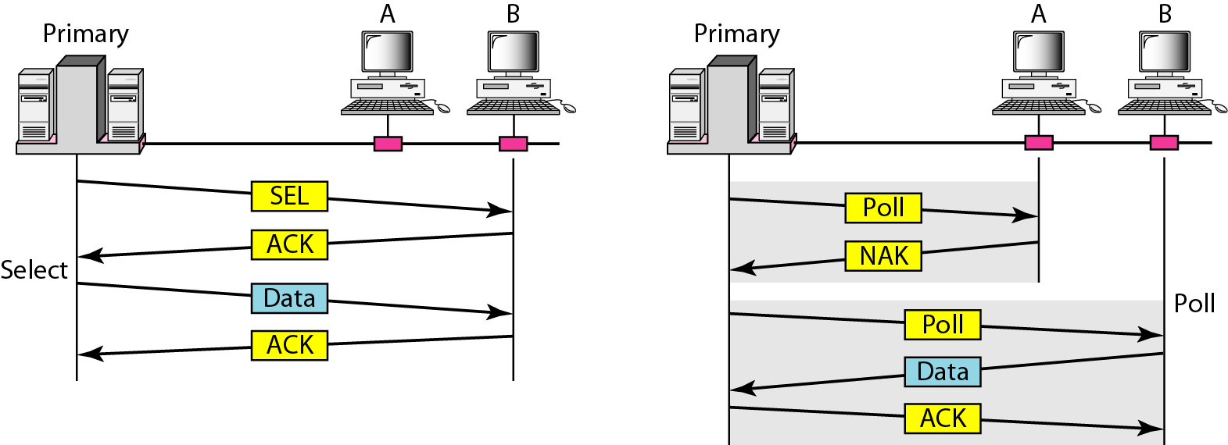
Polling

Slide 59
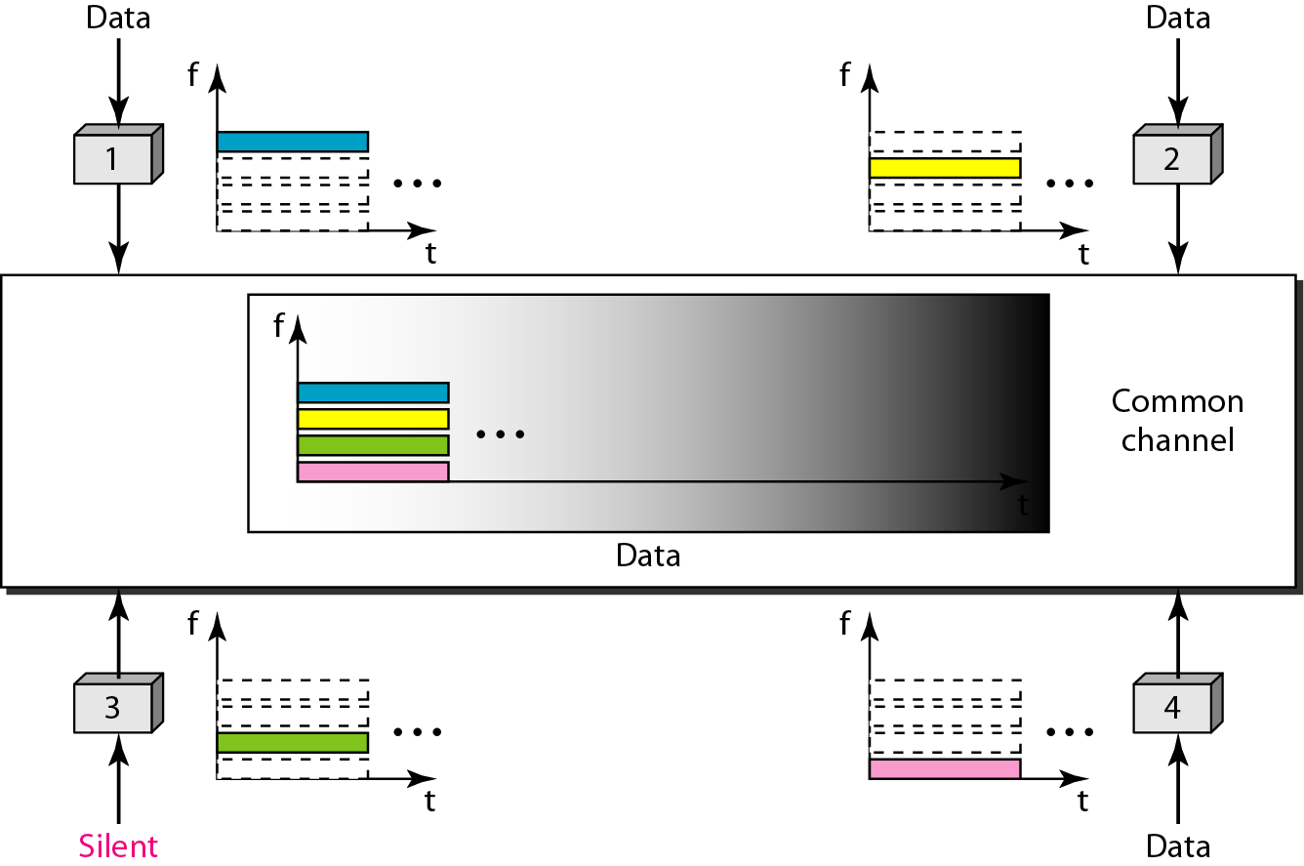
Figure 12.21 Frequency-division multiple access (FDMA)

Slide 60
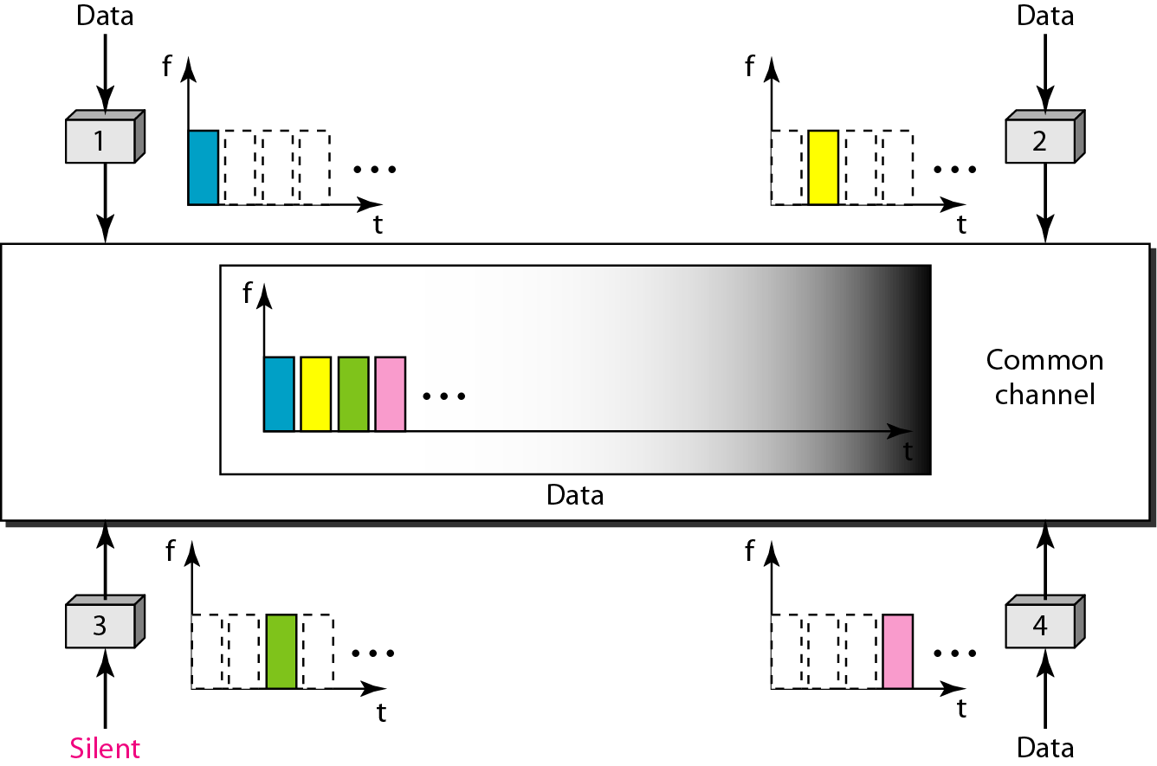
Figure 12.22 Time-division multiple access (TDMA)

Slide 61
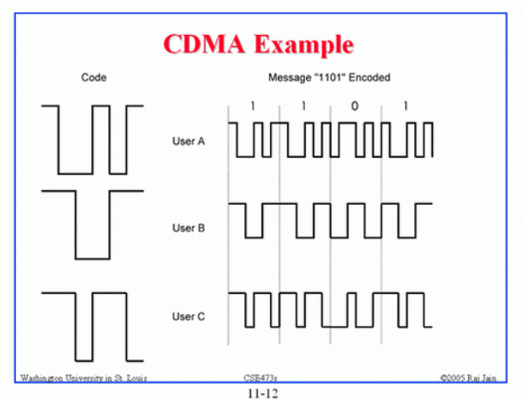

Slide 62
Physical LAyer

Slide 63
Modulation Techniques
Digital Data digital Transmission
Digital Data Analog Transmission
Analog Data Analog Transmission
Analog Data Digital Transmission

Slide 64
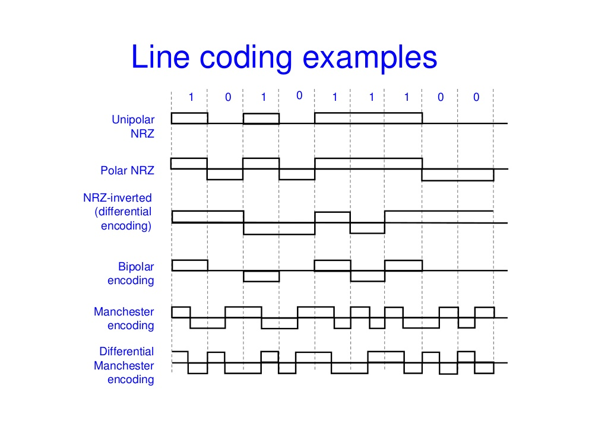
Digital Data Digital Transmission

Slide 65
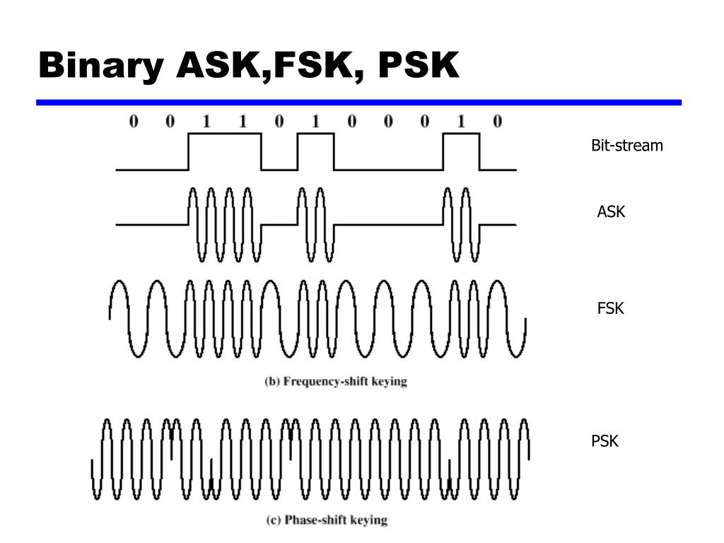

Slide 66
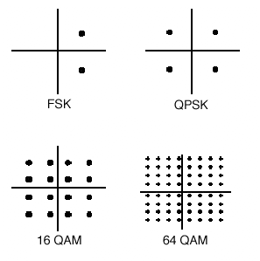
QAM
Quadrature Amplitude Modulation
Constellation diagram

Slide 67
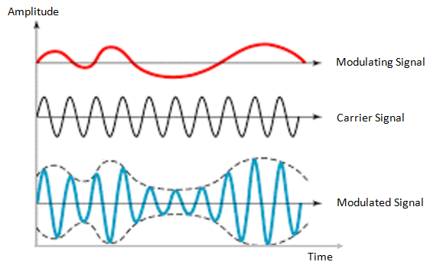

Analog Data to Analog Transmission
Amplitude Modulation
Frequency Modulation

Slide 68

Analog Data to Digital Transmission

Slide 69

Analog Data to Digital Transmission
Delta modulation

